Slide 1
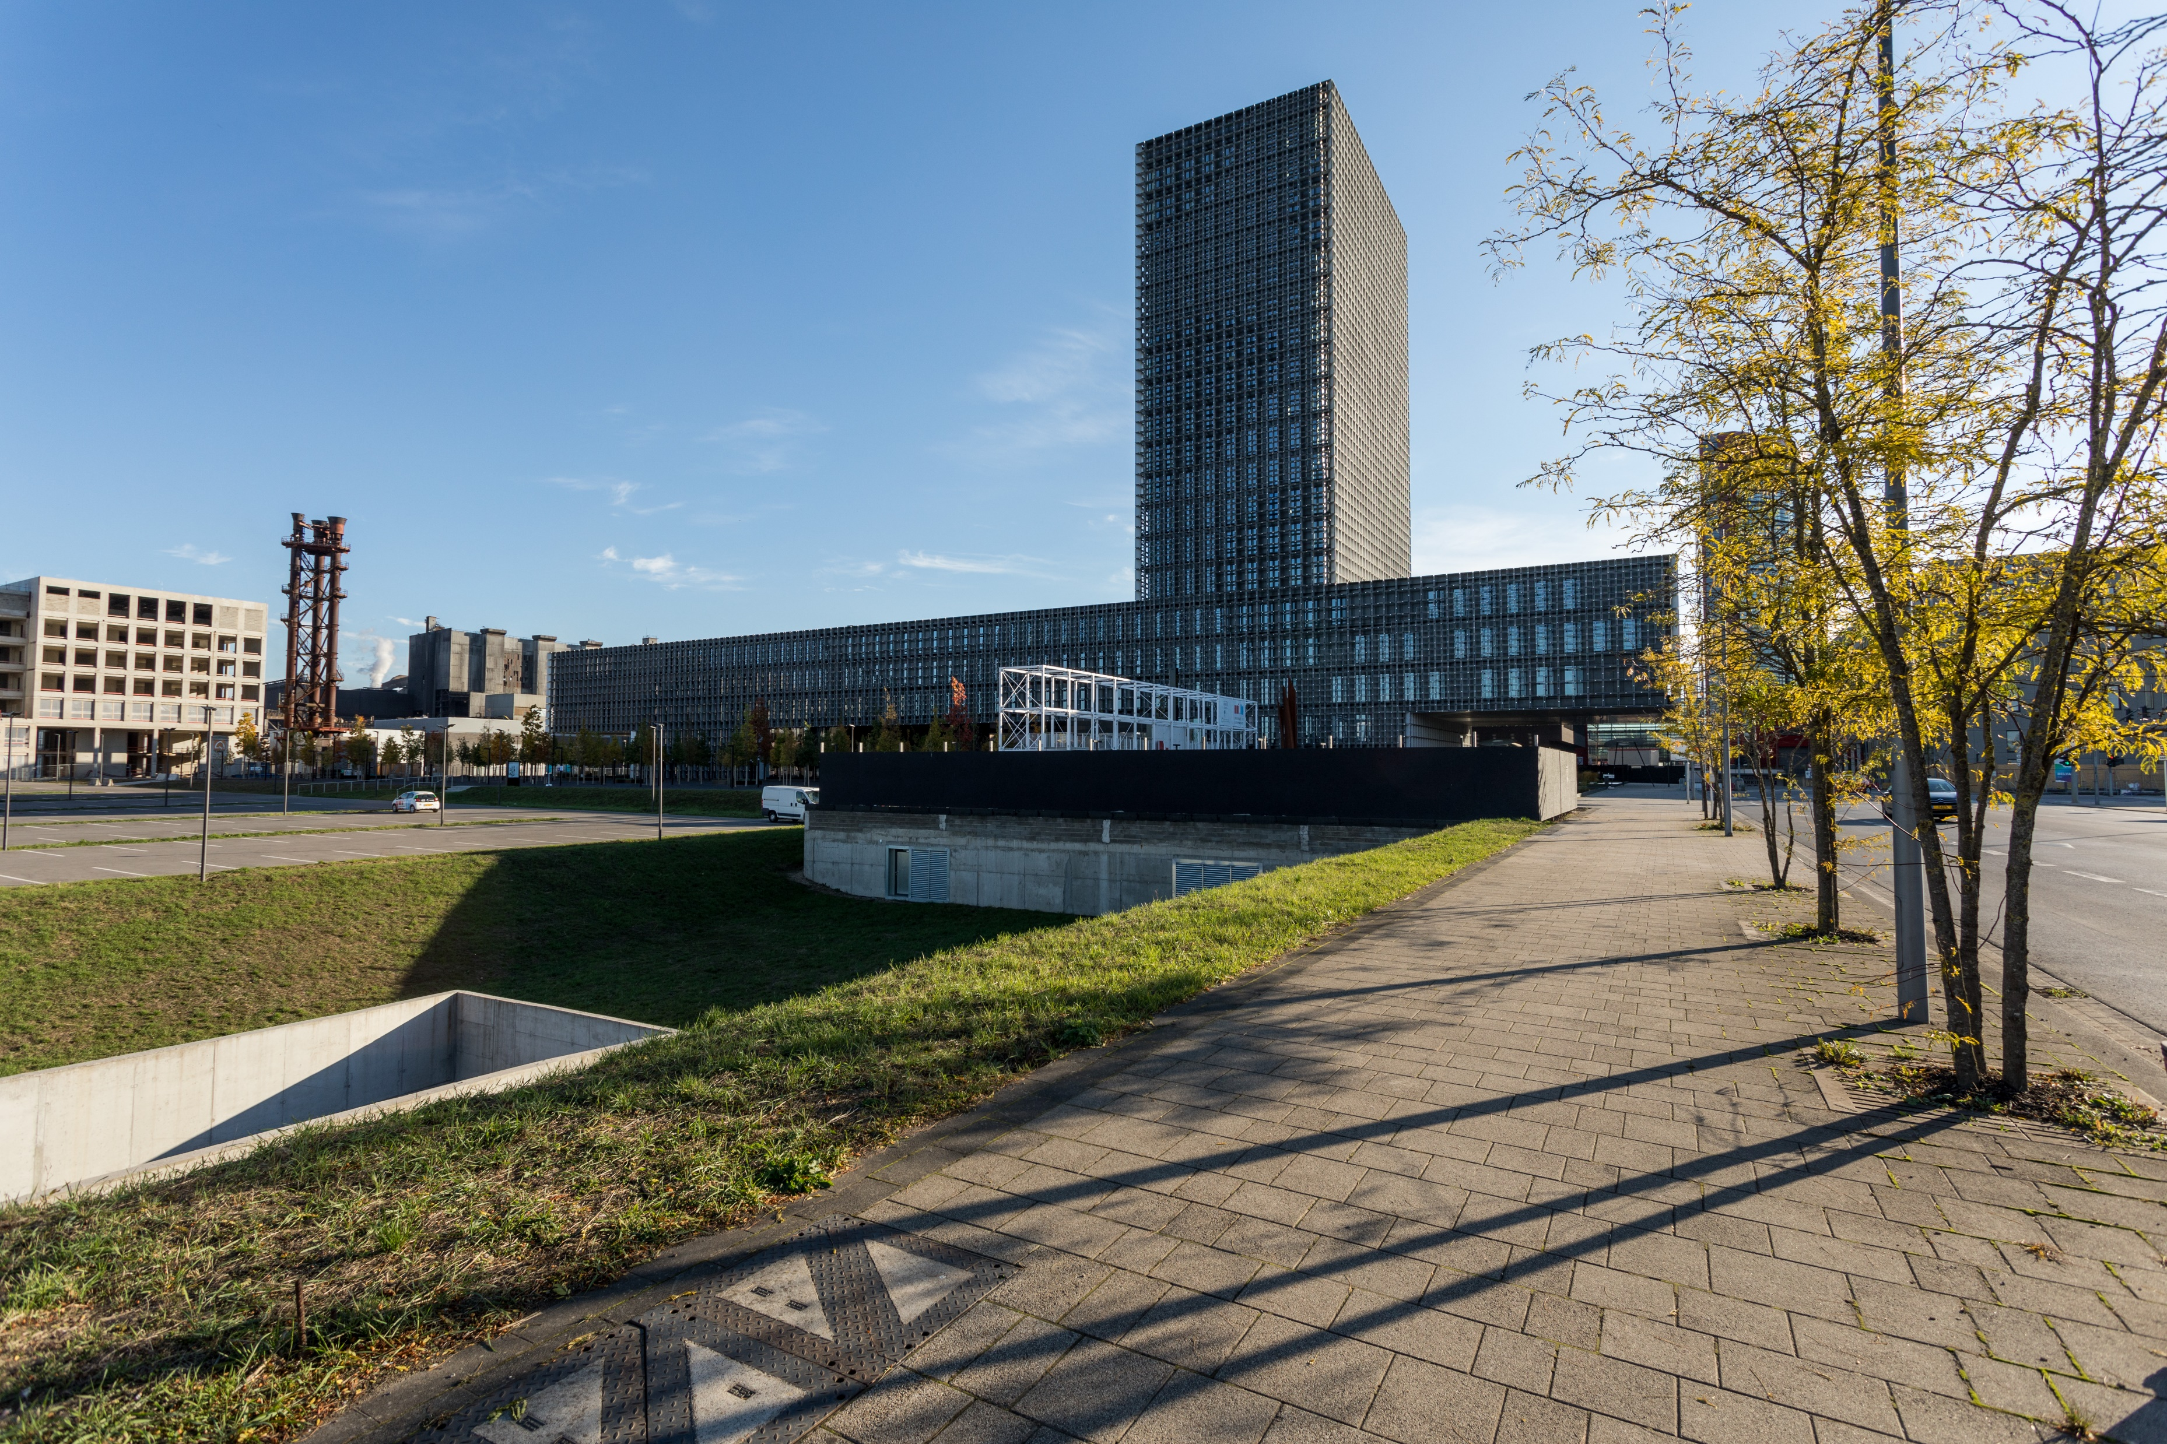
The University of Luxembourg
The University of Luxembourg is an international research university with a distinctly multilingual and interdisciplinary character. The University was founded in 2003 and counts more than 5,000 students and more than 2,000 employees from around the world.
The University’s faculties and interdisciplinary centres focus on research in the areas of Computer Science and ICT Security, Materials Science, European and International Law, Finance and Financial Innovation, Education, Contemporary and Digital History. In addition, the University focuses on cross-disciplinary research in the areas of Data Modelling and Simulation as well as Health and System Biomedicine.
Times Higher Education ranks the University of Luxembourg #4 worldwide for its “international outlook,” #25 in the Young University Ranking 2022 and among the top 250 universities worldwide.

Slide 2
Facts & Figures April 2023
Staff & Students
Rankings
1,500
Academic staff
#25
among the top
in THE (Times Higher Education) Young University Rankings 2022
#250
5,000
Students
2,400
Staff
best universities according to THE World University Ranking 2023
1,000
Doctoral candidates
130
Nationalities
300
Professors
^{#4}
worldwide for its international outlook according to the THE World University Rankings 2023
14,000+
Alumni
(since 2003) thereof 1,500+ doctor’s degrees
Teaching
Research
46
Master’s
degrees
18
Bachelor’s
degrees
2,438
1,000+
Publications in 2022
Ongoing projects
4
Doctoral
schools
40
Bilingual
degrees
172
22m €
Horizon projects accepted for H2020 and HEU¹
For EU funding awarded in 2022
14
Vocational
trainings
4
Teaching
languages
138
44m €
(French, German, English and Luxemburgish)
FNR projects accepted
For FNR² funding awarded in 2022
¹ Total number granted until February 2022. Horizon Europe is the biggest EU research and Innovation funding programme, with a €95.5 billion budget for the 2021-2027 period. It succeeds Horizon 2020, which ran from 2014 to 2020, with a budget of €80 billion. ² The Luxembourg National Research Fund (FNR) is the main funding organism of research activities in Luxembourg.
Vision – Mission
Our Focus Areas
OUR VISION
DIGITAL TRANSFORMATION
Trustworthy ICT | Cybersecurity | Digital humanities | Big Data of the past FinTech | Space technology and telecommunication | Data Science
A University for Luxembourg and the World
OUR MISSION
MEDICINE AND HEALTH
Systems biomedicine | Neuroscience and oncology | Digital Health | Social and economic aspects of health
To be a world-class research university focusing on:
Cutting-edge Research
High-quality education
Contribution to the social, cultural and economic development of the country
SUSTAINABLE AND SOCIETAL DEVELOPMENT
Sustainable finance and governance | Inequalities | Diversity and migration | Law and regulations | Educational research
The University
Our Approach
2003
Foundation
International
Interdisciplinary
3
3
3
Multilingual
Research Orientated
Faculties
Interdisciplinary Centres
Campuses
Close to European Institutions, financial institutions and leading industry players

Slide 3
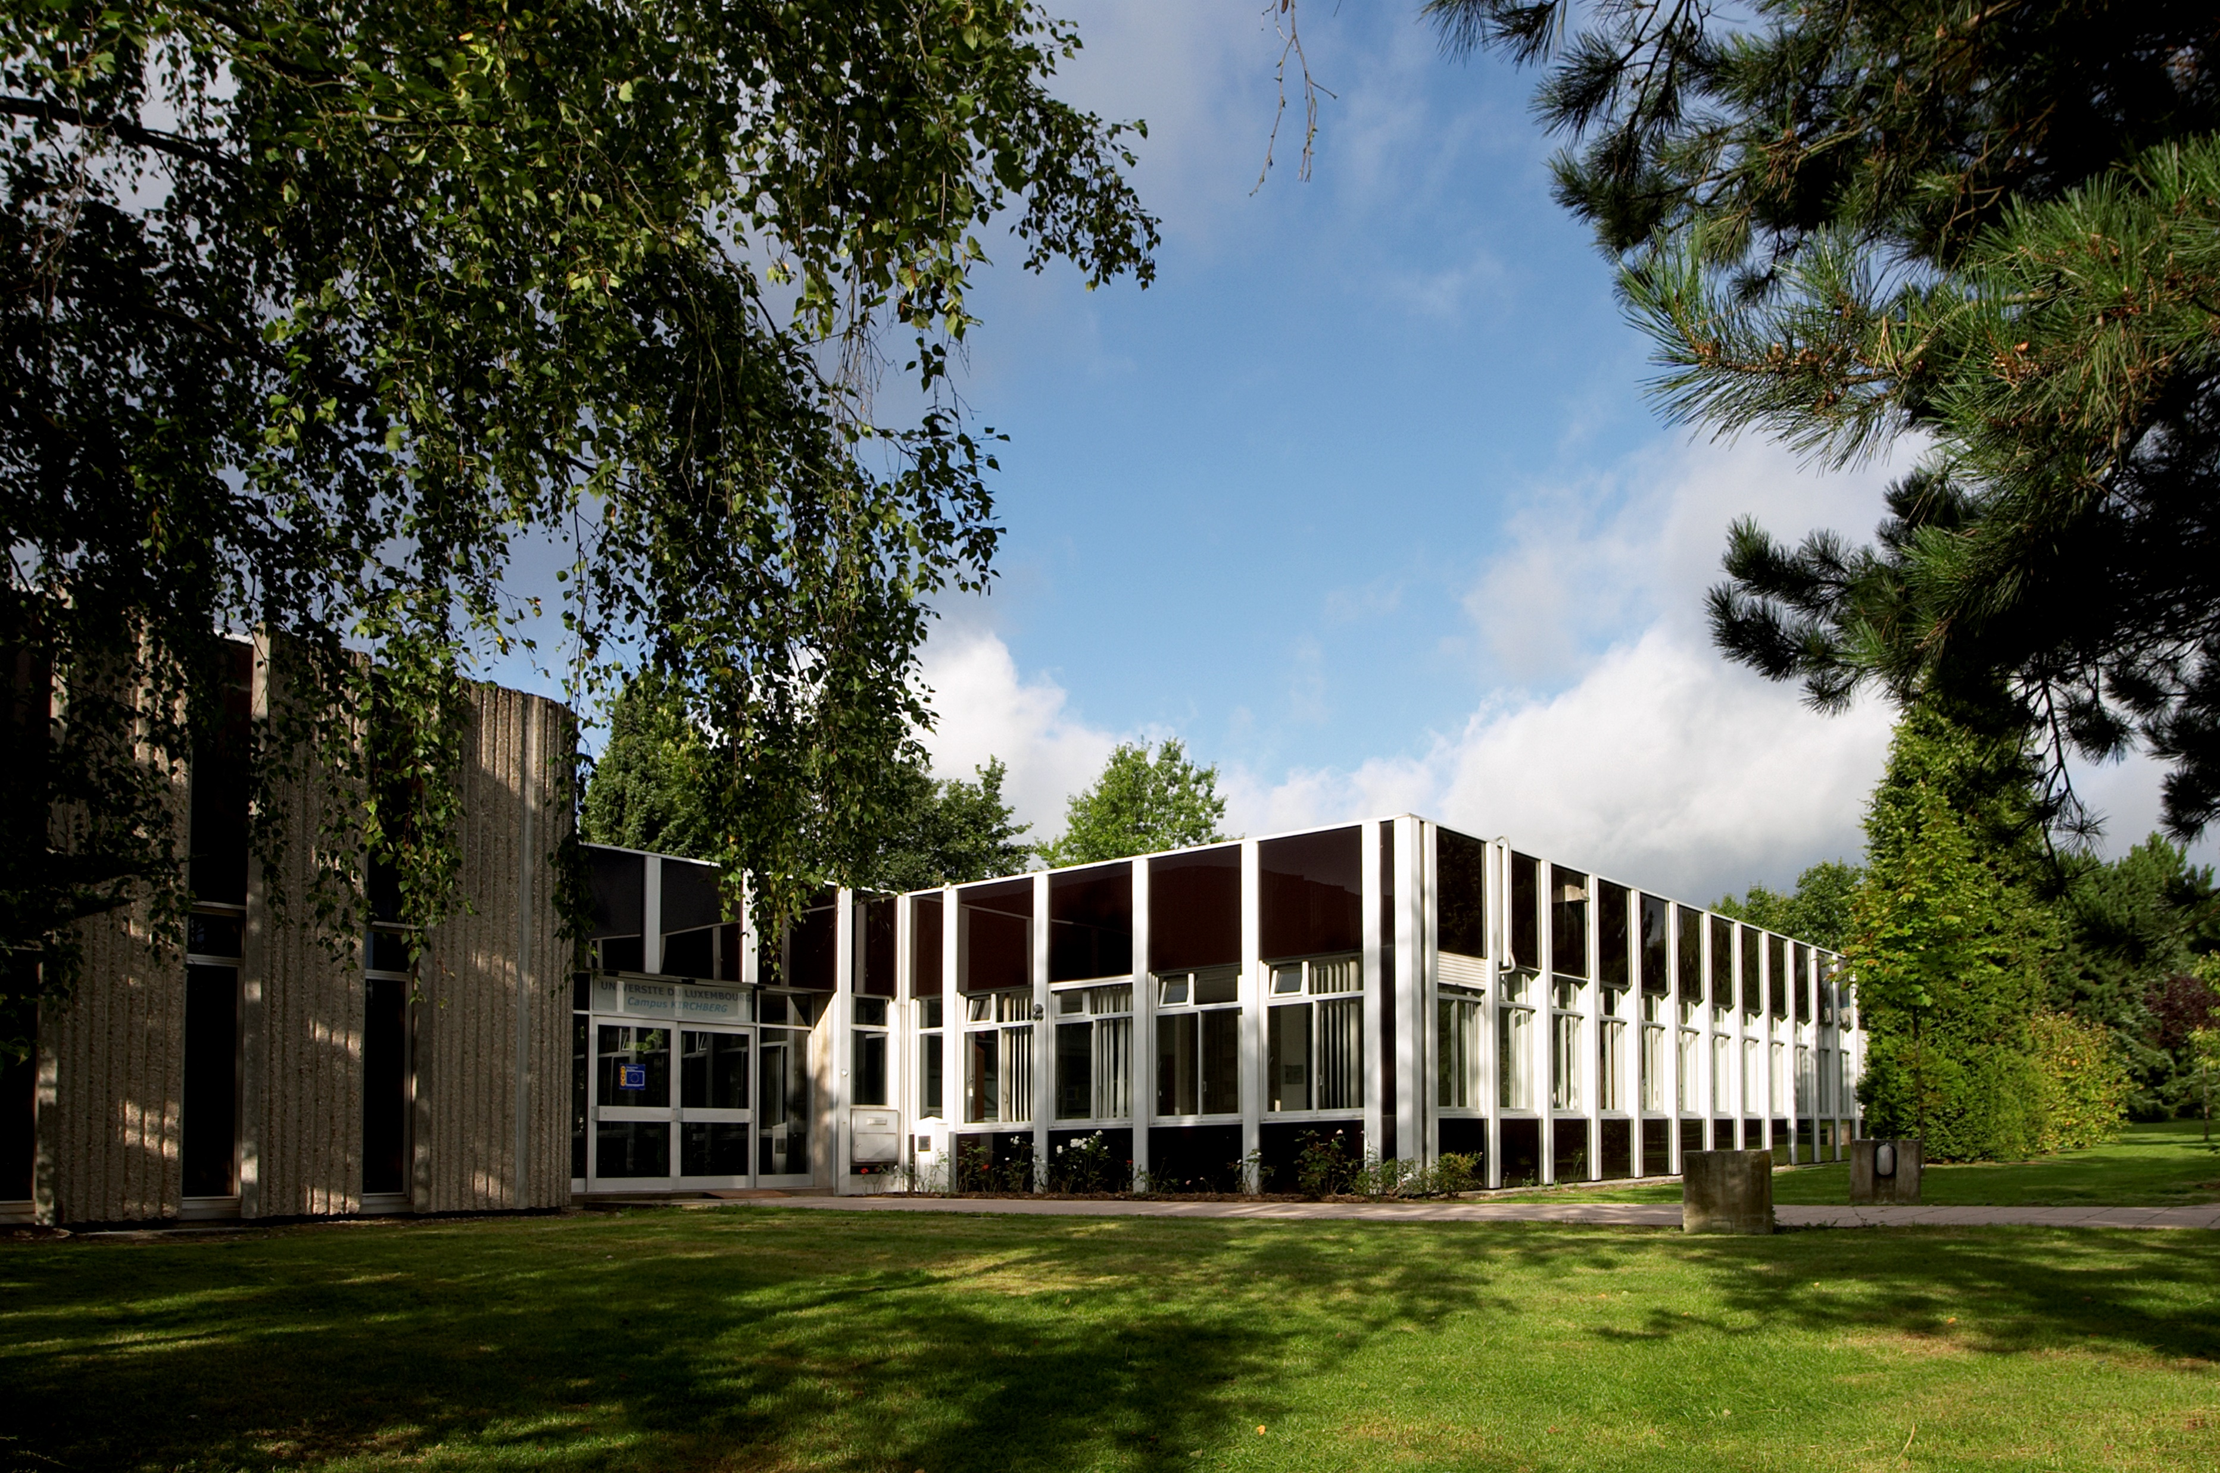
Incoming Mobility
Incoming mobility students may join the University of Luxembourg within one of the following exchange programmes:
Erasmus+ - programme for EU universities only
Erasmus+ International Credit Mobility (ICM) – Erasmus programme between EU and non-EU universities
Inter-University agreements - direct exchange agreements with EU universities
Fulbright - special exchange programme for US students (more information on fulbright.be)
Free mover - Free Mover applications are accepted only if a cooperation agreement(s) exists between your University and the University of Luxembourg but such agreement(s) does not include your study programme.
Double degree - special degree programmes with our partner universities
Global Exchange – exchange programme with non-EU partner Universities
Institutional Information
Name of the Institution
Faculties
University of Luxembourg
Faculty of Science, Technology and Medicine (FSTM)
Erasmus identification code
Dean
Prof. Pascal BOUVRY
LUXLUX-VIL01
Faculty Mobility Officer / OLA responsible
Elizabeth ADU TWUMWAA (fstm.studentmobility@uni.lu)
OID
E10208960
President
Faculty of Law, Economics and Finance (FDEF)
Prof. Dr. Jens KREISEL
Dean
Prof. Katalin LIGETI
Legal Adress
Faculty Mobility Officer / OLA responsible
Stephanie ANDERSON (stephanie.anderson@uni.lu)
2, avenue de l’Université, L-4365 Esch-sur-Alzette, Luxembourg
Website
Faculty of Humanities, Education and Social Sciences (FHSE)
http://wwwen.uni.lu
Dean
Prof. Dr. Robert Hamsen
Faculty Mobility Officer / OLA responsible
Nathalie CHARPENTIER (nathalie.charpentier@uni.lu)

Slide 4
Incoming Mobility
Procedures & Deadlines
Good to know
General procedure
Language Requirements in main teaching language
https://www.uni.lu/en/mobility/incoming-exchange-students/
Equivalent to B2 level (minimum)³
Language centre
Nomination Deadline for EU and non-EU students ¹
https://www.uni.lu/en/about/organisation/administration/language-centre/
Winter Semester: April 15th
Summer Semester: October 15th
Accomodation
https://wwwen.uni.lu/students/accommodation/general_information
Application Deadline for EU and non-EU students
Mental Health & Wellbeing
https://www.uni.lu/life-en/mental-health-wellbeing/
Winter Semester: May 15th
Summer Semester: November 1st
Inclusion & Diversity
https://www.uni.lu/life-en/equality-inclusion-diversity/
Public transport
¹ Nominations can only be done by the home university,
nominations done by students will not be accepted.
Link to nomination: https://tinyurl.com/af4h6hev
Public transport within the Grand-Duchy of Luxembourg is free of charge
https://www.mobiliteit.lu/en/
³ The course programme is often bi- or trilingual
Useful contacts
International Relations Office
Staff & Teaching Mobility
bri@uni.lu
From within Europe
Karin LANGUMIER
karin.langumier@uni.lu
Incoming Mobility Office
Ms Natalie KIRF, Ms Sophie RUFFO
(+352) 46 66 44 – (5915) or (6490)
From outside Europe
Alison VERMEULEN
alison.vermeulen@uni.lu
bri.incoming@uni.lu
Outgoing Mobility Office
Inclusion & specific needs office
bri.outgoing@uni.lu
Mrs Joanna WEST
(+352) 46 66 44 – 6783
Agreements & Partnerships
inclusion@uni.lu
erasmus.agreements@uni.lu
bri.partnerships@uni.lu
Access our academic calendar

